Slide 1

CYTOAUTOCLUSTER
Semi-Supervised Deep Clustering for Cytometry Data Analysis
-Swarna U

Slide 2
Introduction
Project Overview:
This project aims to automate the clustering of cytometry data using deep learning and semi-supervised learning techniques. The objective is to enhance the accuracy and interpretability of cell population identification
Goals:
Implement a semi-supervised deep clustering model.
Use data exploration, preprocessing, and visualization for better model performance.

Slide 3
Category | Details
Cells | Total of ~150,000 cells analyzed.
Markers | 32 markers
Labeled Data | 104,185 rows
Unlabeled Data | 45,815 rows
Clusters | 14
Data Overview
Dataset : Levine 32-dimensional dataset, including features and labels.
Key Columns:
Example: CD45RA, CD133, CD19, CD4, CD8, etc.
Data Characteristics:
Contains labeled and unlabeled data.
Labels are NaN from row 104186 onward, used to split data into subsets for training and testing.

Slide 4
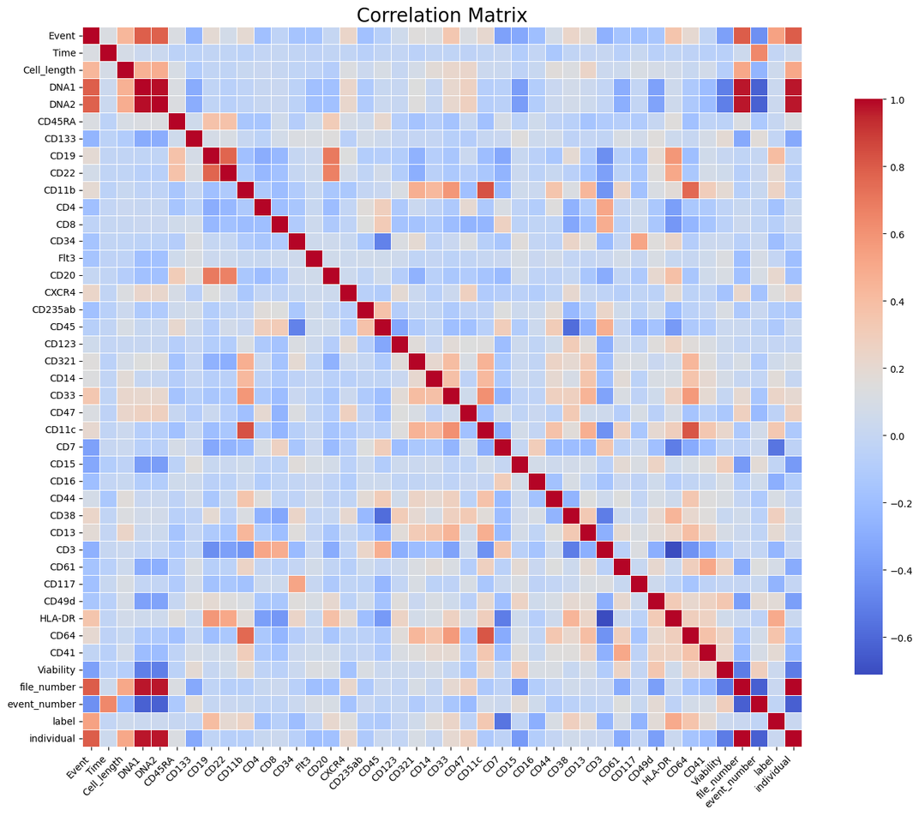
Data Exploration & Preprocessing
Exploration Steps:
Initial data analysis to understand distribution and feature relationships.
Use of correlation matrices and visualizations to identify feature relationships.
Preprocessing Steps:
Normalization and scaling of data.
Splitting the data into labeled and unlabeled subsets.

Slide 5
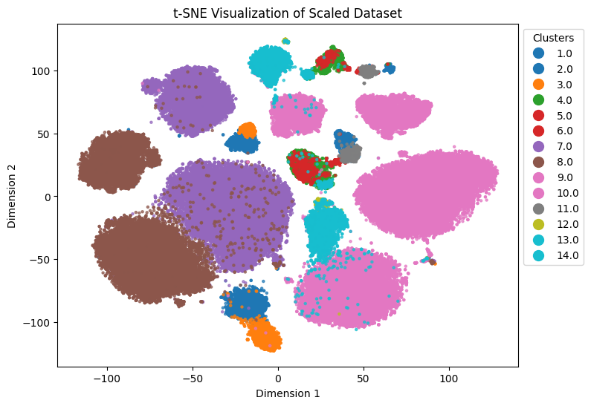
t-SNE before Encoder:
Objective:
Perform dimensionality reduction and visualize high-dimensional cytometry data to identify potential clusters..
Insights:
Highlights potential clusters in the dataset before applying the encoder model.
Provides a baseline understanding of data structure for downstream analysis.
Method:
Applied t-distributed Stochastic Neighbor Embedding (t-SNE) to reduce 32-dimensional data to 2D space.
Visualizes similarities between data points based on feature relationships.

Slide 6
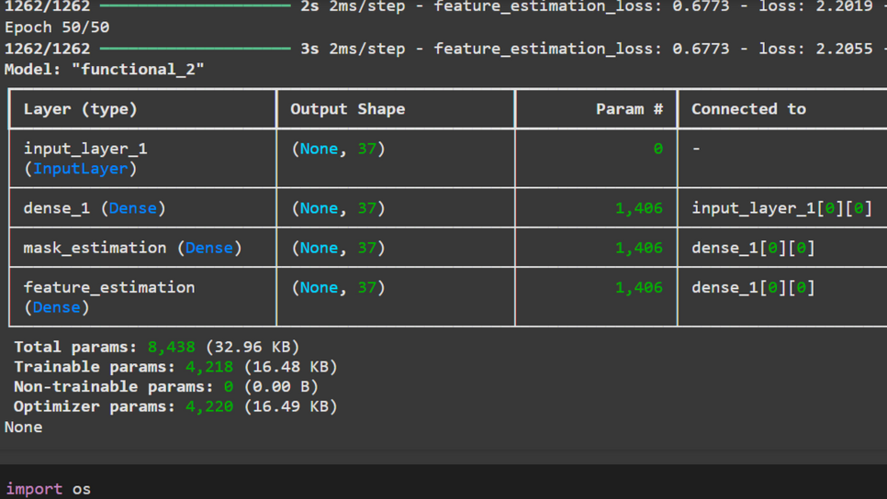
Model Architecture
Encoder Architecture:
Built as a deep autoencoder with:
Input Layer: 32 features.
Hidden Layers: Decreasing layer sizes (e.g., 128 → 64 → 32 → latent space).
Latent Space: Compressed representation of input data.
Decoder: Symmetric structure to reconstruct input data.
Activation Functions: ReLU for hidden layers, sigmoid for the output layer.
Optimizer: Adam with learning rate 0.001.
Loss Function: Mean squared error (MSE) for reconstruction loss.

Slide 7
Model Training
Logistic Regression:
Achieved an log loss of 0.11511803835329242 using encoded features as input.
XGBoost:
Achieved a log loss of 0.07188946205290861, validating the quality of latent features.
Semi-Supervised Learning:
Utilized both labeled and unlabeled data with a deep clustering approach.
Achieved [Accuracy: 0.910543744301003 ,AUROC: 0.9858937931143635], demonstrating improved generalization.

Slide 8
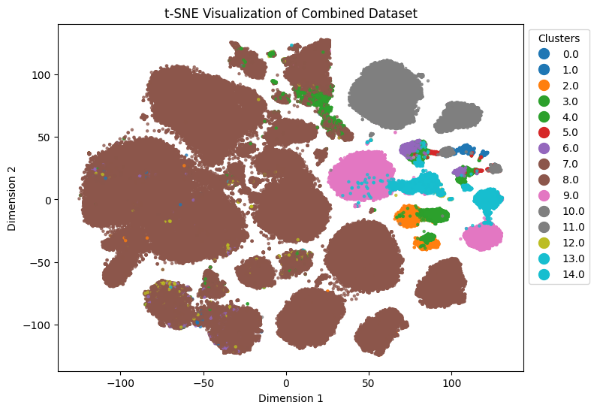
Unlabeled Predictions:
Predicted clusters for unlabeled data using the trained semi-supervised model.
Results reveal [key insight, e.g., clear separation into clusters or meaningful groupings].
Insights:
Clear separation between clusters indicates the encoder successfully captures feature relationships.
Improved cluster structure compared to pre-encoder t-SNE visualization.
Comparison with Pre-Encoder t-SNE:
Enhanced cluster compactness and separation demonstrate the encoder's effectiveness.
.
t-SNE after Encoder

Slide 9
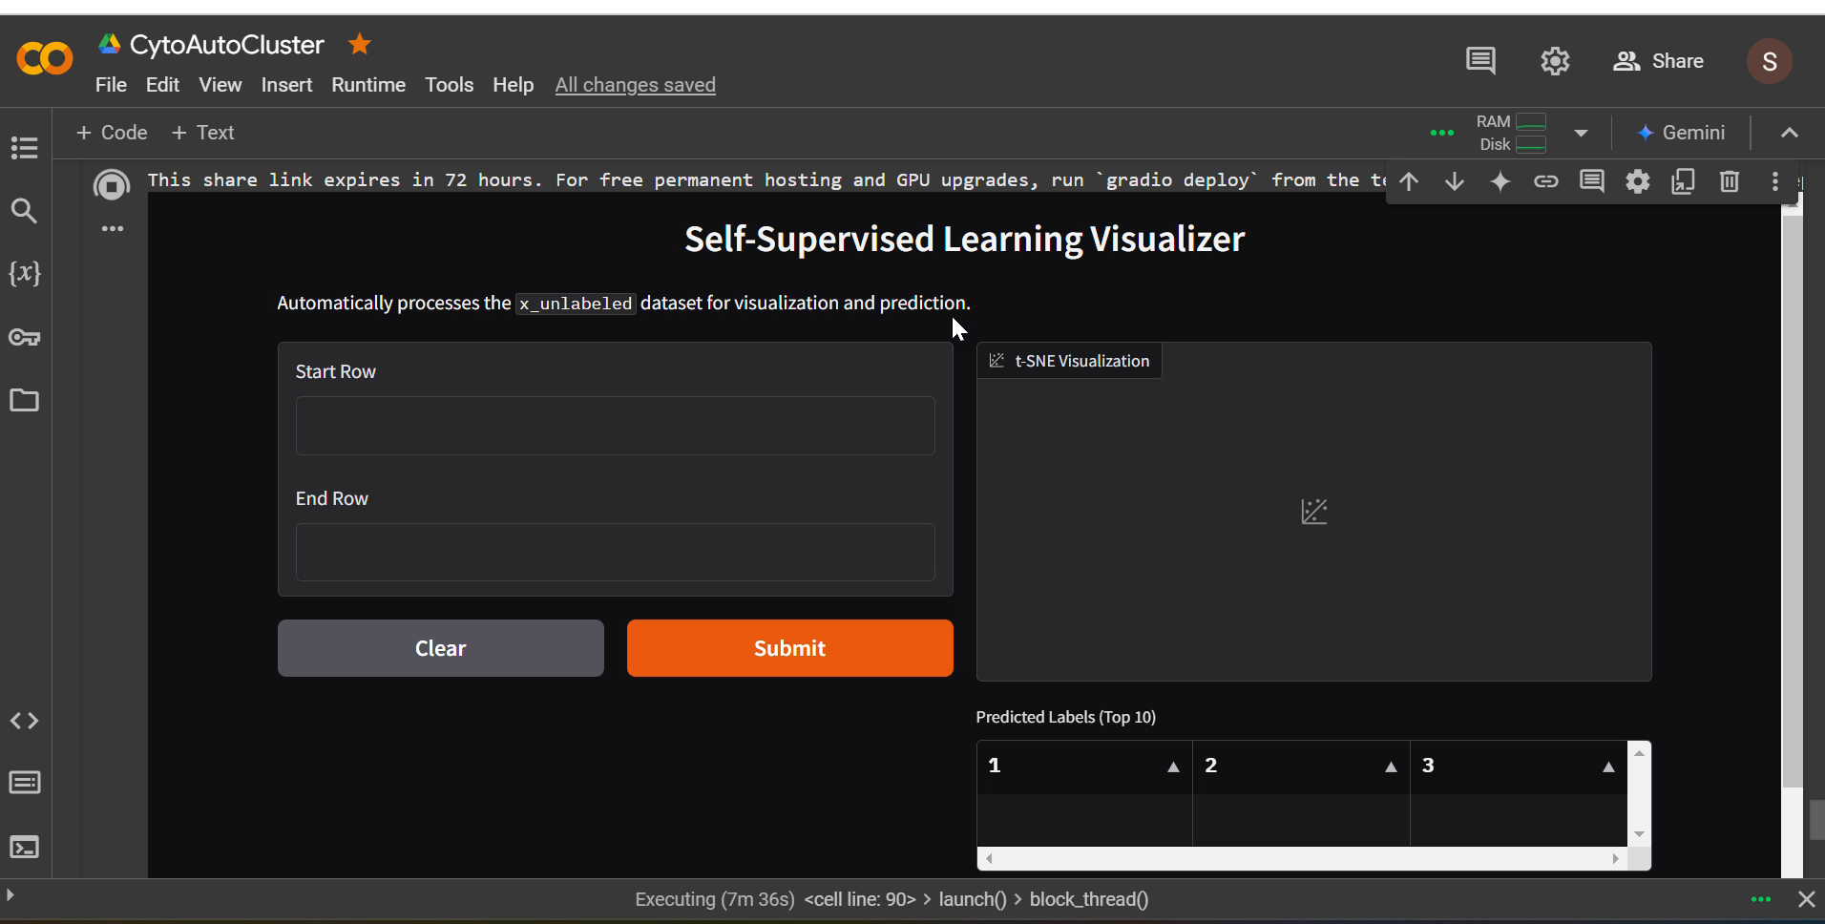
Demo of Gradio Interface

Slide 10
Thank you

